Slide 1

WOLDIA UNIVERSITY
FACULTY OF TECHNOLOGY
DEPARTMENT OF COMPUTER SCIENCE
WOLDIA UNIVERSITY
FACULTY OF TECHNOLOGY
DEPARTMENT OF COMPUTER SCINCE
CVIP Project on:
Ethiopian Car Plate Number Recognition System Using Matlab
Section One Group 10
Submitted to: Instructor Sebahadin Nasir (MSc)
January 30, 2019
Woldia, Ethiopia

Slide 2
Introduction
Now a days most system are changed into automated system to make easier to use and secured. But, Ethiopian car plate are identified manually for the purpose of security especially related to traffic system and parking systems.
The traffic police may miss the car if the speed of the car is too high. So, to control those cars that make a crime can be easily cached by this system.
In Ethiopia there are many cars with their own unique car plate. Each car plate have their own description for instance the nine Ethiopian nation and nationality and the two city administration have their own unique ID like for Amhara AM, for Tigray TG, for Oromo OR, etc... So, by this proposed system any in our domain car can be identified easily.

Slide 3
Applications
Parking
Tolling
Border control
Identifying stolen car easily
Help in identification of car with unpaid tickets

Slide 4
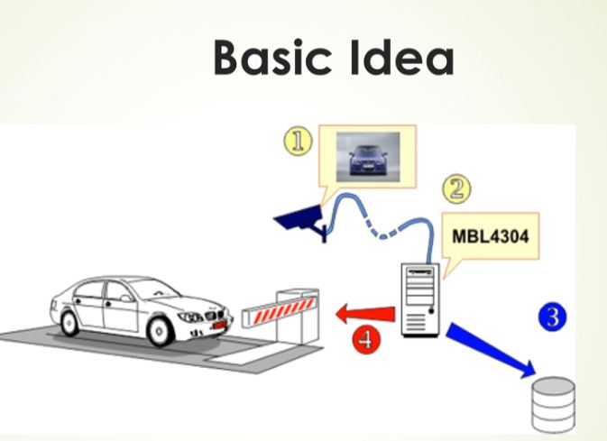
Basic idea in parking

Slide 5
Problem domain description
Today Ethiopian national security force and Ethiopian police commission uses manual system to track the wanted car. Since it is manual it have many problems like:
Time consuming
Improper use of resource
Lack of accuracy
Lack of satisfaction
Lack of speed

Slide 6
Scope of the project
The scope of this project is:
Loading the image from their source
Preprocessing the loaded image
Segmenting the preprocessed image
Loading the segmented image
Saving the features of the images
Loading the saved features
Training the system
Recognizing and interpreting the system

Slide 7
Objective of the project
General objective
The general objective of this project is to develop automated Ethiopian car plate recognition system.
Specific objective
The specific objective of this project is:
To collect requirements.
To study the existing system.
To study the analysis.
To design the interface.
To implement it
To test it

Slide 8
Data Collection
Image collection methods
We use Random collection method for collecting different car plate images like Amhara AM, Oromia OR, Ethiopia ET, and Addis Ababa AA and also there are many other like UN for United Nation in Ethiopia for the input of this project. Simply we capture car plates in our surrounding whether it is Bajaj, Sino truck, Landcruser , …
2.Image set description
Image class | Number of image | Image extension | Spatial resolution
AM (Amhara) | 17 | .jpg | 70
AA (Addis Abeba) | 30 | .jpg | 70
ET (Ethiopia) | 58 | .jpg | 70
UN (United Nation) | 2 | .jpg | 70

Slide 9
Cont,
2.Image acquisition parameters
To collect the car plate images we used our smart phones due to this our image have some quality problem due to different parameters like: [1]

Slide 10
Cont…
Motion blur/blur due to subject
Improper holding of camera
Shake due to internal vibrations
Dirty lens
Focus

Slide 11
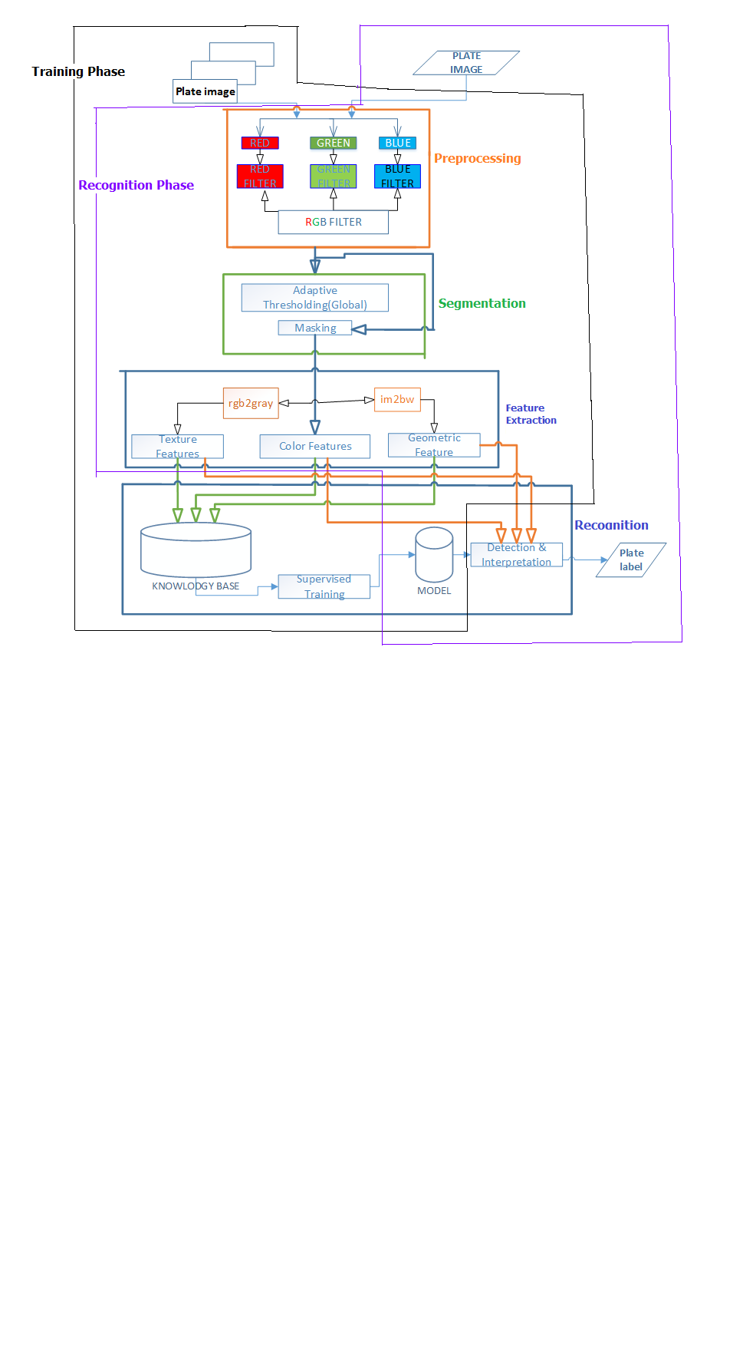
Architecture of the designed CVIP system

Slide 12
Summary
The main objective of this project is to develop automated Ethiopian car plate recognition system to minimize the risk and error that appear in Ethiopian traffic police system as well as in Ethiopian national defense to identify one’s car using it’s car plate and also to minimize the time that takes to investigate and to identify one’s car using it’s car plate. In this system we used random selection method to collect car plate images and we used our smart phones to capture the car plates from the cars. During this project development we face many problems like difficulties to get car plate images that are not appear here like Somalli (SO),Benshangul (BN) car plates, ….., disagreement and conflicts to capture one’s own car plate from his or her car and the last but not the least that we face problem is lack of time to make this project strong enough since we have the final project as well as courses to be studied.

Slide 13
Cont…
Finally after the completion of this project it is very useful for the sake of security in National security offices well as Ethiopian police commission and for parking purpose to identify wanted person by his or her driving car. It saves computation time to identify or to recognize one’s car using its car plate and also it is accurate and secured

Slide 14
Reference
Sebahadin Nasir,” Image acquisition lecture notes on chapter 2” woldia university faculty of technology department of computer science, woldia Ethiopia, October, 2017.

